Slide 1
Lung Disease Analysis using X-Ray/MRI Scans
Mini Project
PH-01 Simon Henry
PH-19 Prashant Wadekar
PH - 25 Aayush Shukla
PH - 27 Kanishk Singhania
PH-28 Kuldeep Pawar

Slide 2
Our project aims to assist in the detection and classification of various lung diseases (which include pneumonia and tuberculosis to name a few) on the basis of medical imagery provided.
The medical imagery includes datasets of X-Ray and MRI scans images.
Problem Statement

Slide 3
This model is designed to operate the classification on two levels :
Binary Classification
If a lung disease is detected, the model provides the specific disease which has been detected :
“Tuberculosis” or “Pneumonia”
or “Lung Cancer”.
Multiclass Classification
Multiclass Classification
Whether the MRI scan shows a disease or not :
“Lung disease detected” or “Lung disease not detected”

Slide 4
Technologies Used:
Environment Used :
Ipynb file ( Python Notebook)
Visual Studio Code/Google Colab
Libraries Used :
Pandas
Numpy
Matplotlib
Tensorflow
Sci-kitlearn
Keras
Seaborn
Cv2 ( openCV )
OS module

Slide 5
Scope :
We aim to assist medical professionals in detecting lung diseases instantly with higher accuracy along with the the relevant analysis.
We aim to perform various data analysis operation on the patient’s information provided in the dataset.
Data Limitations :
Inconsistent image quality produced when multiple datasets are merged.
Very limited numbers of disease region bounding boxes

Slide 6
DATASETS USED :
Chest X-Ray Images (Pneumonia) : https:/www.kaggie.com/paultimothymooney/chest-xray-pneumonia
Montgomery County X-ray (MCX) : http://openl.nim.nih.gov/faq.php
Lung Cancer Detection Challenge (LUNA16):https:/www.kaggle.com/c/data-science-bowl-2017/data
ChestX-ray14 Dataset:https:/nihcc.app.box.com/v/ChestXray-NIHCC
Japanese Society of Radiological Technology (JSRT) Database:http:/db.jsrt.or./p'eno.prp
LIDC-IDRI: https:/wikl.cancerimagingarchive.net/display/Public/LIDC-IDRI

Slide 7
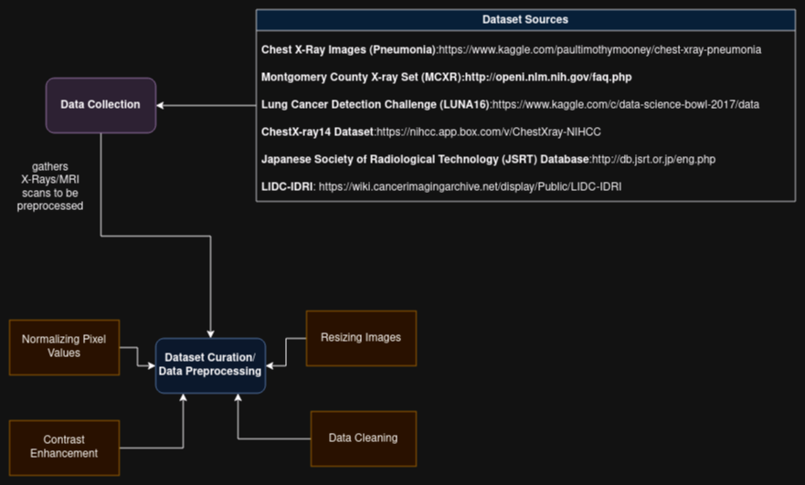
IDENTIFYING DATASETS

Slide 8
DATA PREPROCESSING
Image Preprocessing
Resize: Adjust image dimensions to a standard size.
Normalize: Scale pixel values to a consistent range.
Data Augmentation
Rotate
Scale
Flip
Final Data Output
Preprocessed images are saved or transmitted to the AI Model.

Slide 9
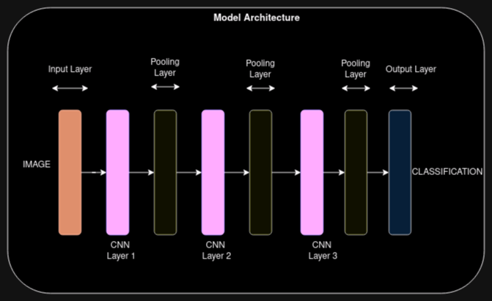

Slide 10
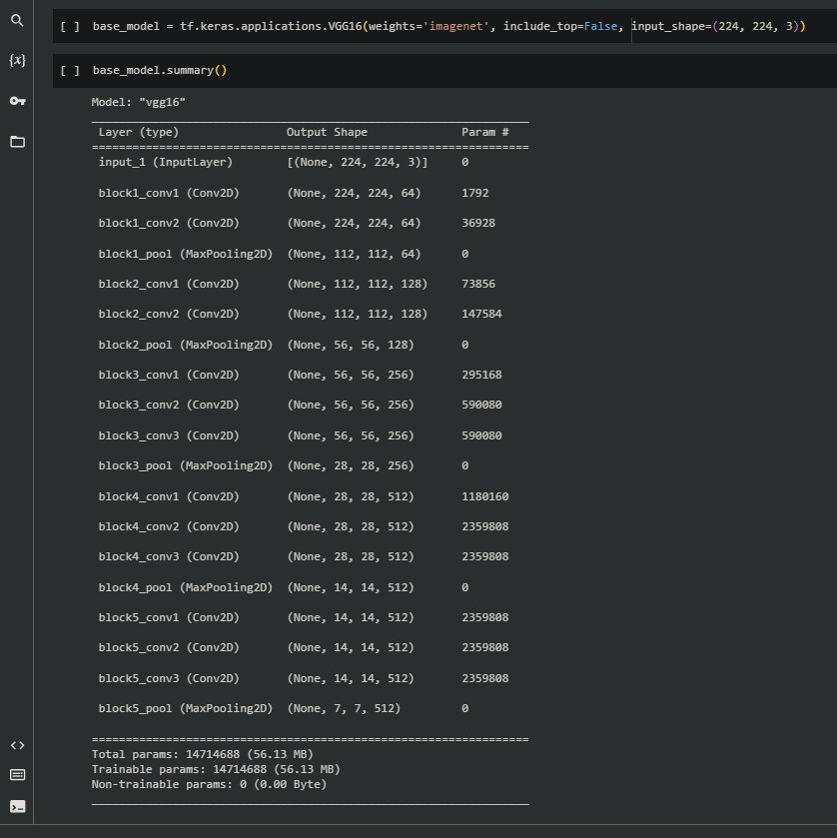
CLASSIFIER MODELS
Transfer Learning
We have use a pretrained VGG16 model as our base model.
It is a very deep Convolutional Network used for large scale image recognition.

Slide 11
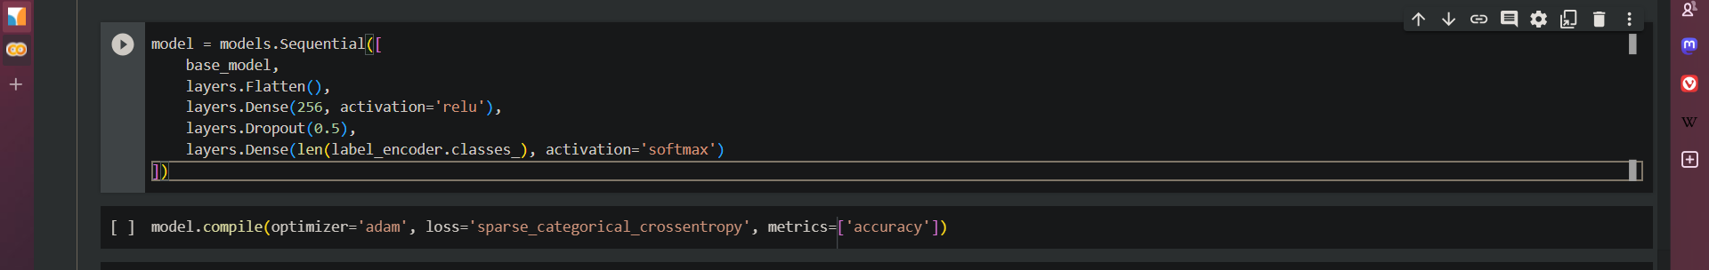
Our Model
To the base model, we add our own classifier layer so that we can tailor it according to our requirements i.e. detecting diseases in X-ray/ MRI Scans.

Slide 12
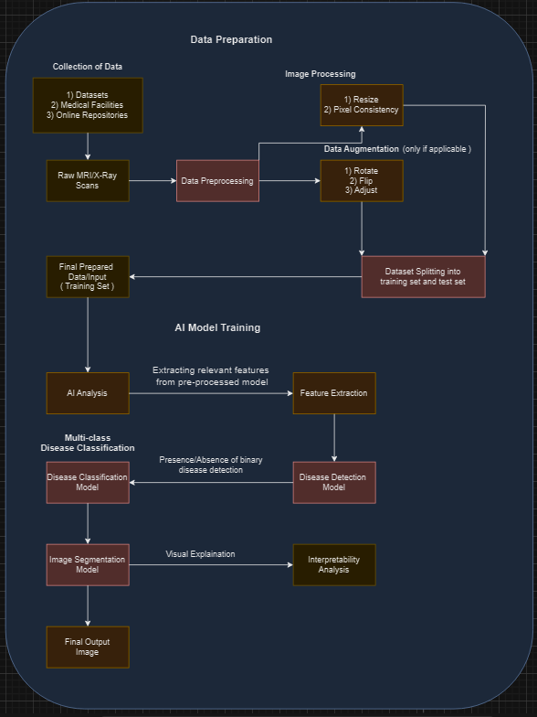
SYSTEM ARCHITECTURE

Slide 13
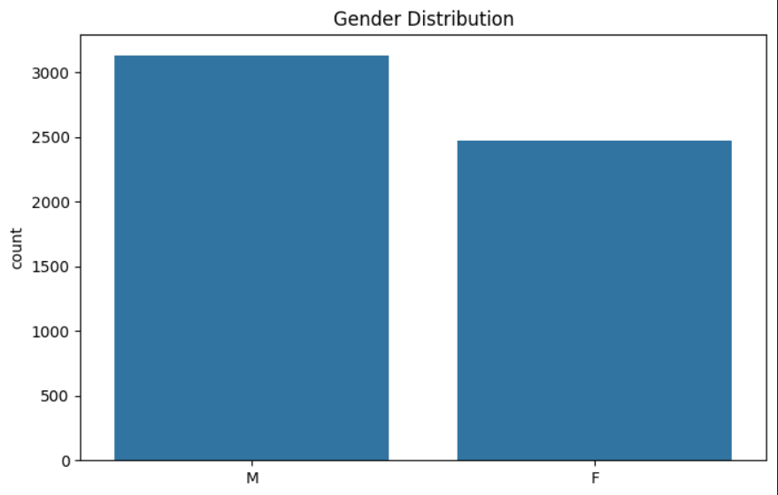
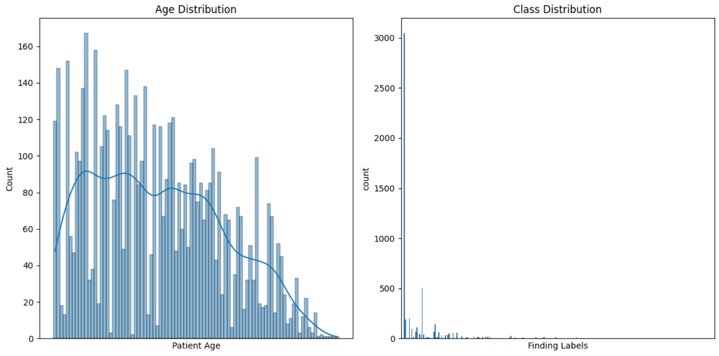
ANALYSIS AND VISUALIZATION

Slide 14
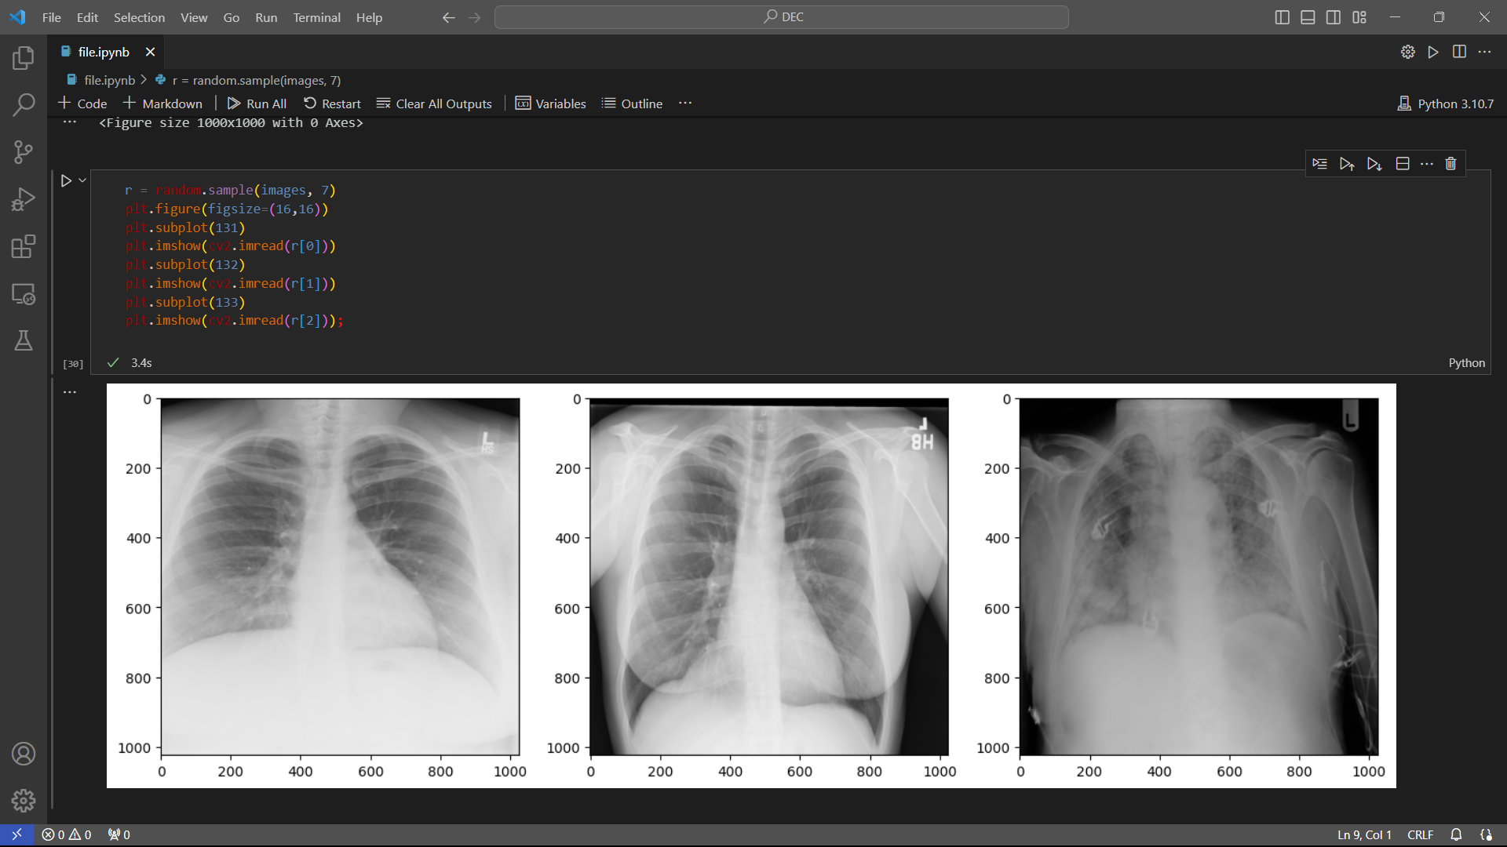

Slide 15
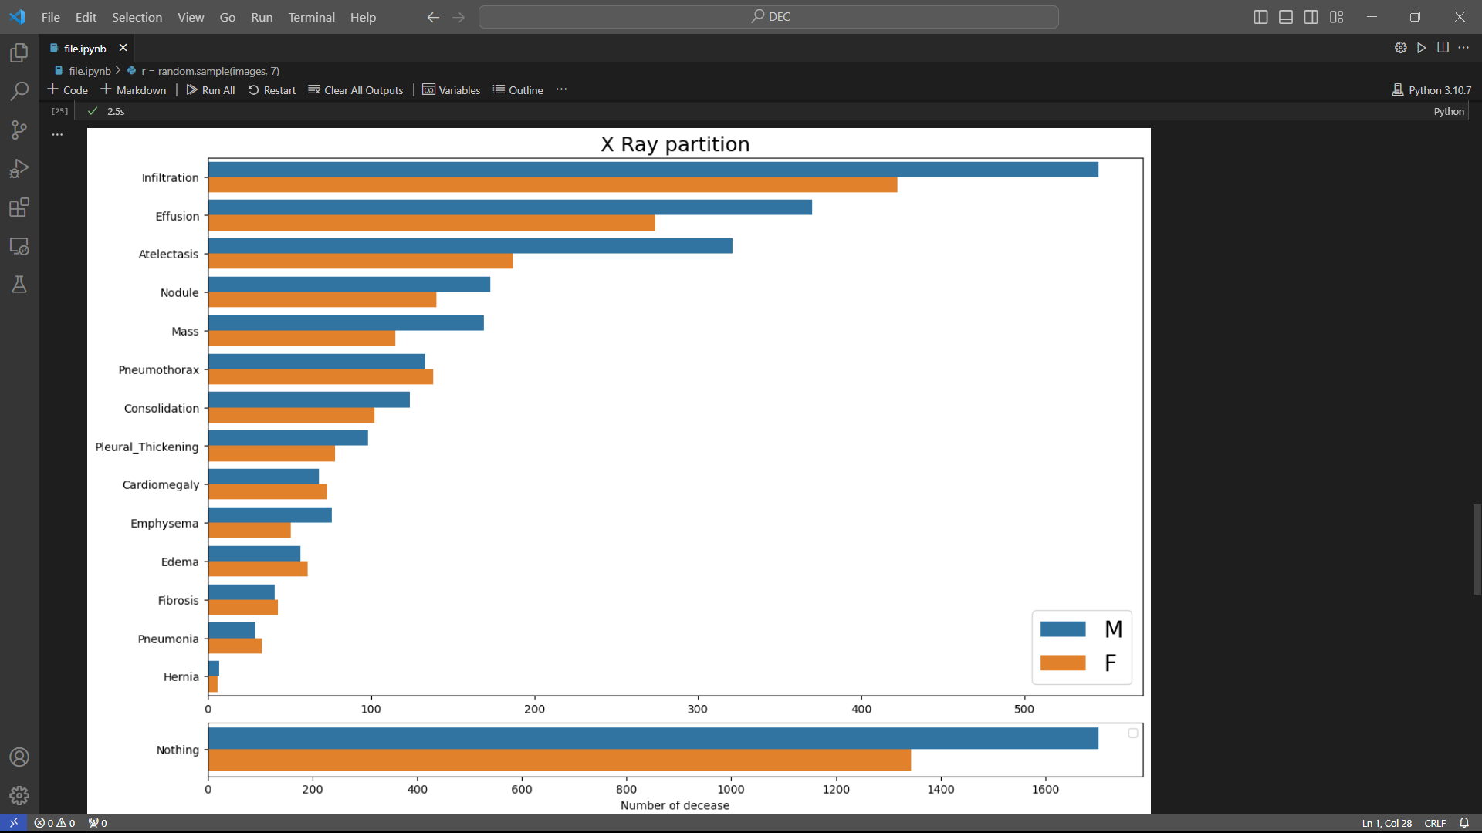

Slide 16
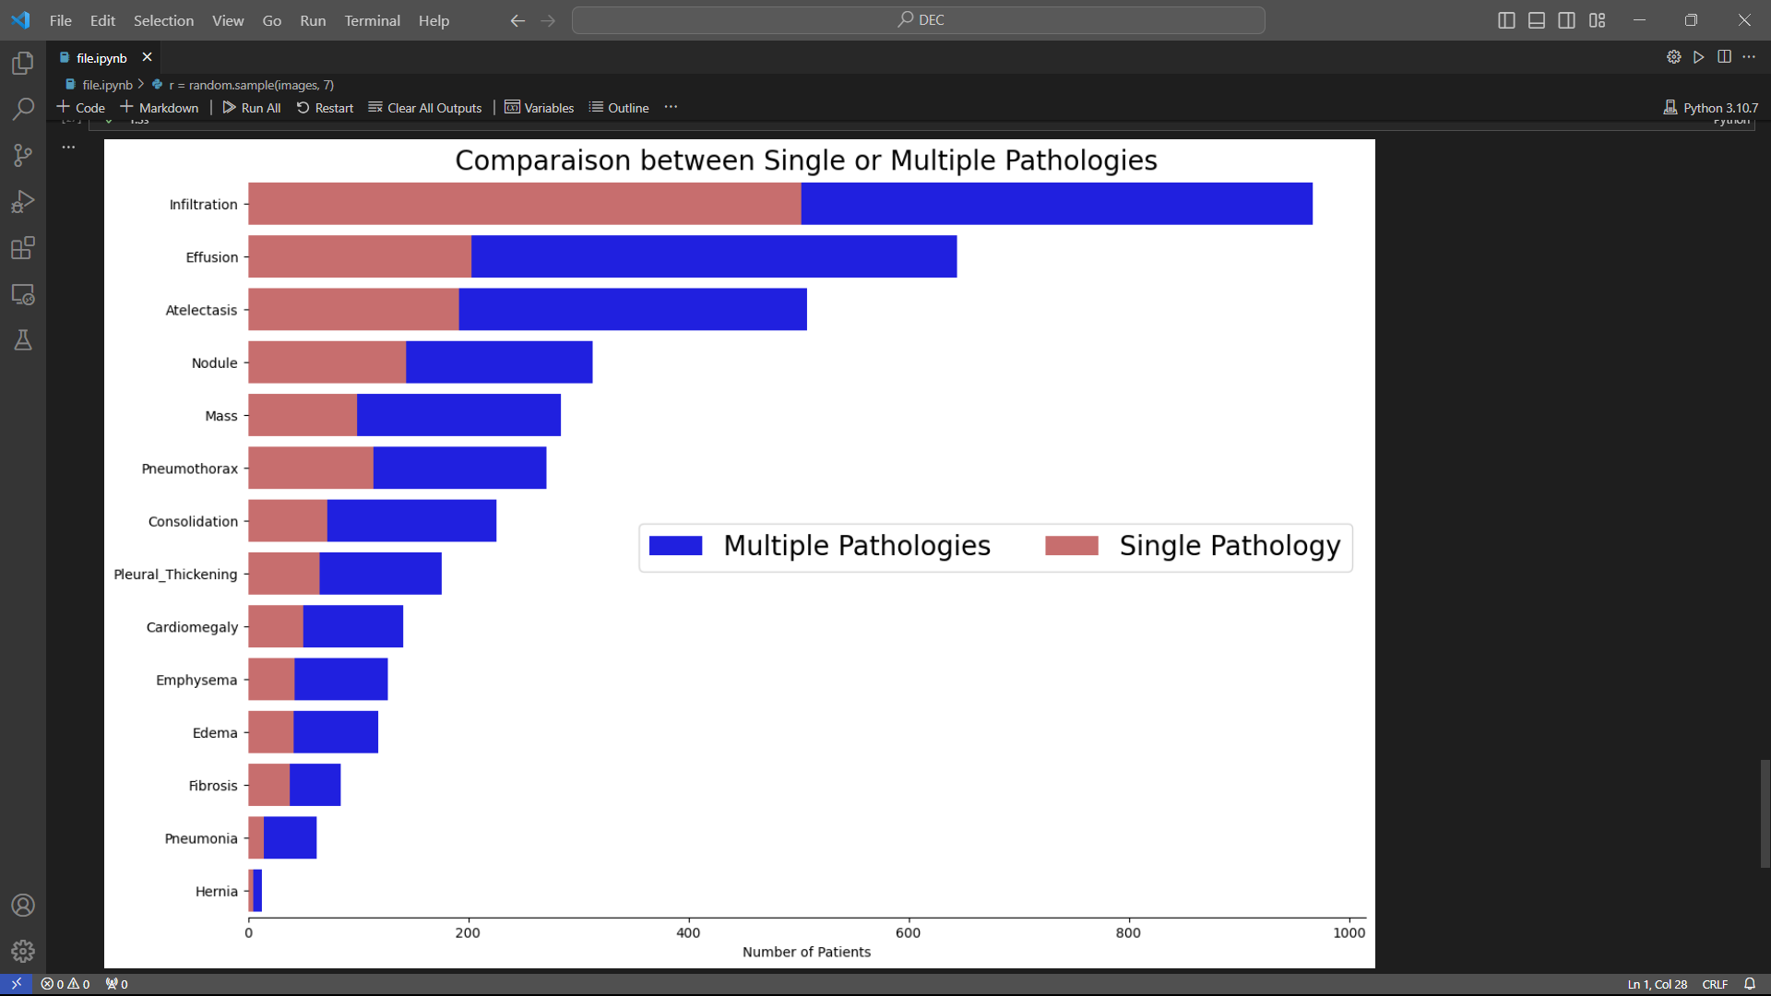

Slide 17
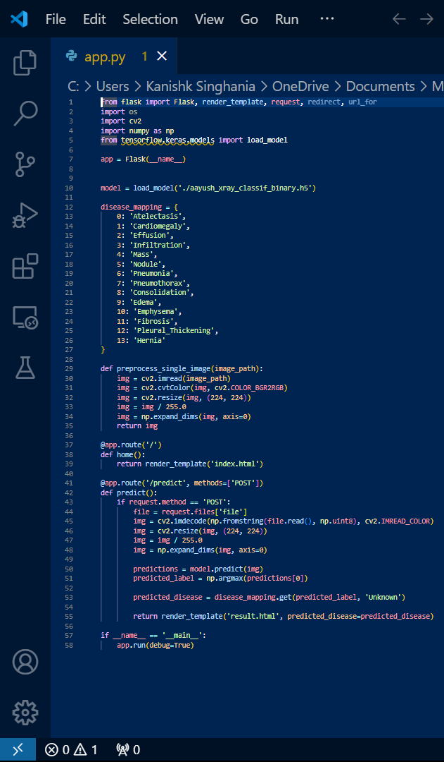
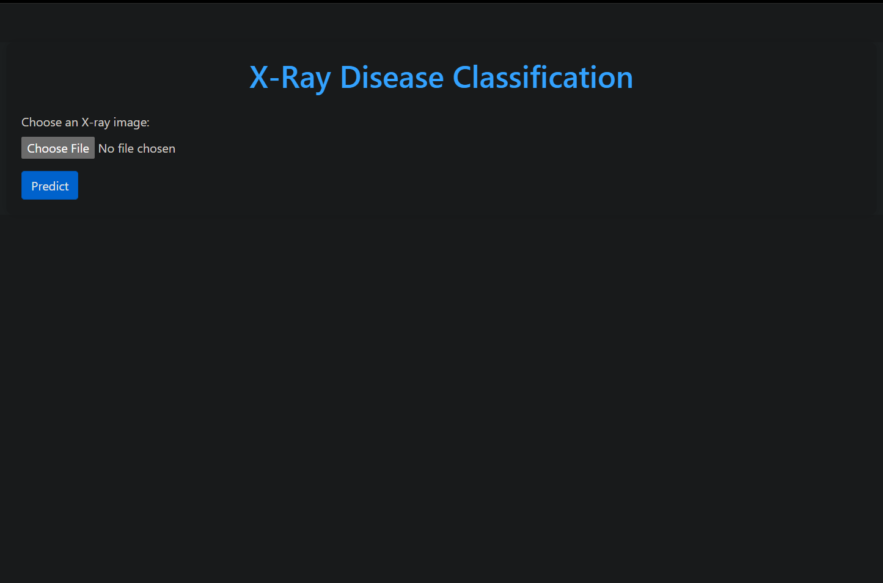
FRONTEND WORKING

Slide 18
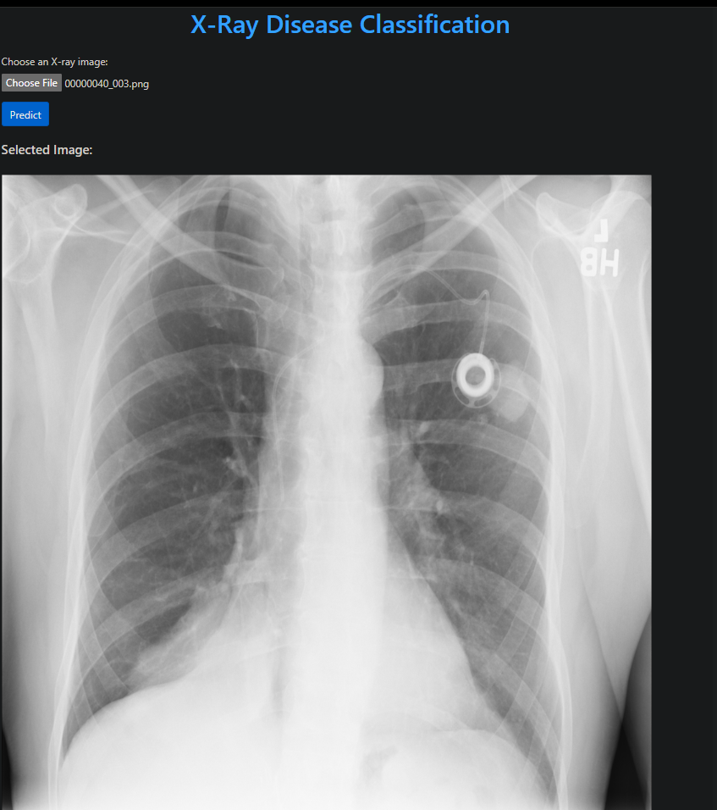
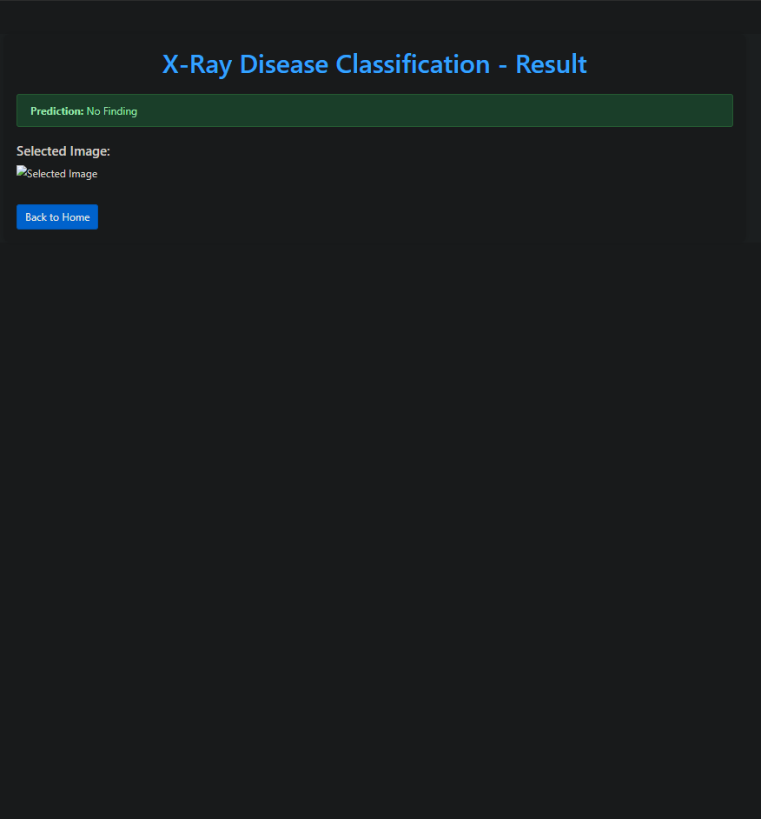

Slide 19
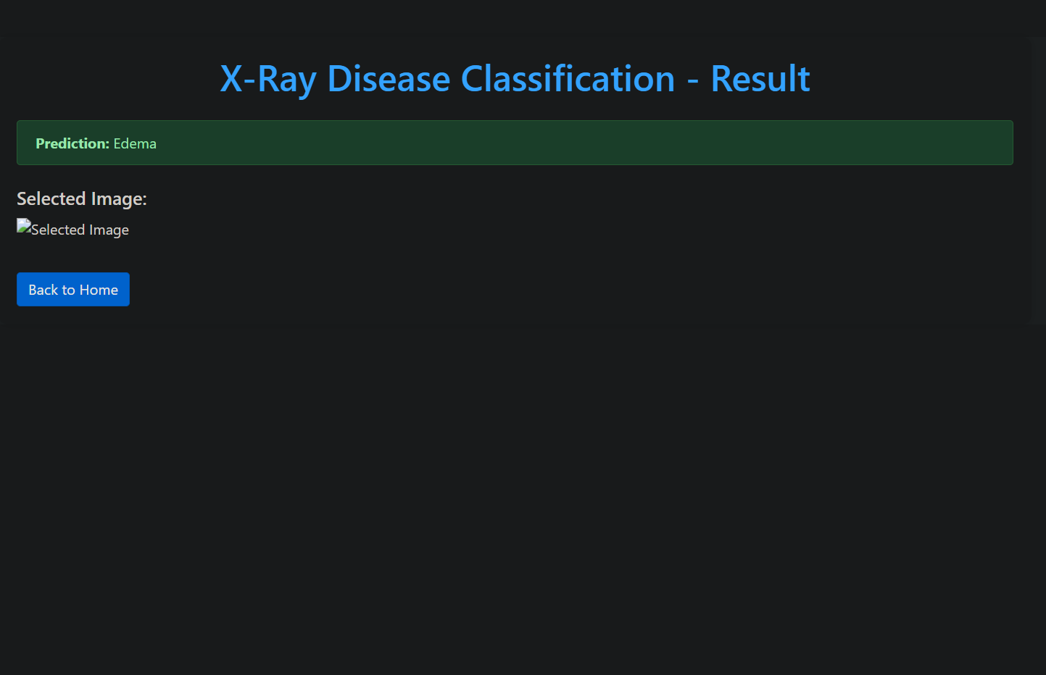
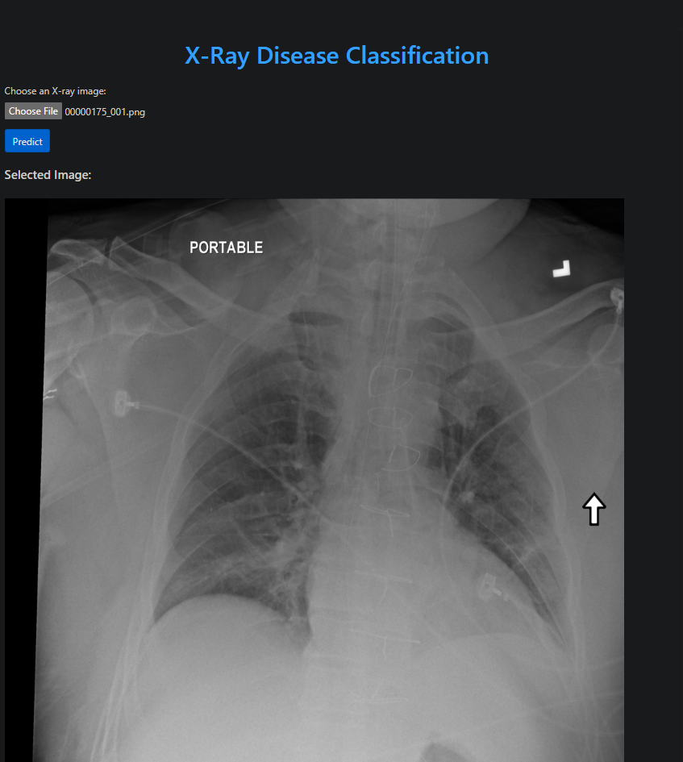

Slide 20
CONCLUSION
Our analysis of lung disease data revealed valuable insights into the distribution of diseases, providing a foundation for further exploration and targeted interventions in Healthcare and Research.

